Slide 1
STAT 717: Class 11
Clustering
Vitaly Druker
November 11th, 2021

Slide 2
Introduction
EFA is just that – exploratory
Loadings are not unique due to ability to rotate
Confirmatory Factor Analysis has constraints that ensure a unique set of model parameters – i.e. a hypothesis
Can be thought of as a subset of structural equation modeling – which often has an ‘outcome’ variable.

Slide 3
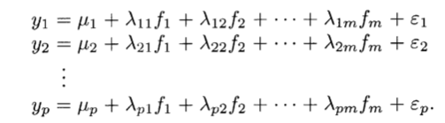

Model Specification and Identification
Recall:
$y=μ+Λf+ε$
This is our definition of factors:

Slide 4
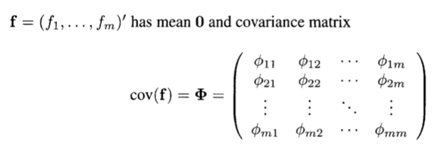
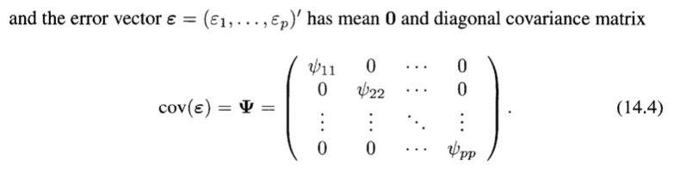

Slide 5
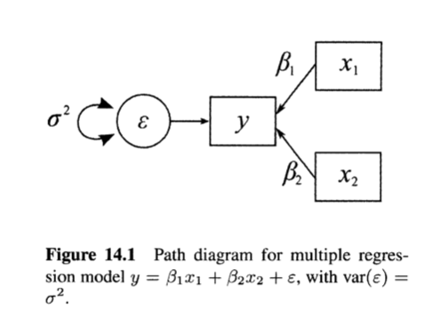
Path Diagram
Circle – unobserved
Square – observed
Double arrow – covariance
Single arrow - effect

Slide 6
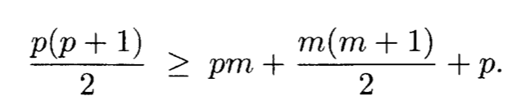
Identified Models
p x p covariance matrix has p (p + 1)/2 statistics
The unconstrained model has pm loadings + m ( m + 1)/2 factors variances. We want to simplify so that:
Even if this is met – we are not guaranteed identifiability.

Slide 7
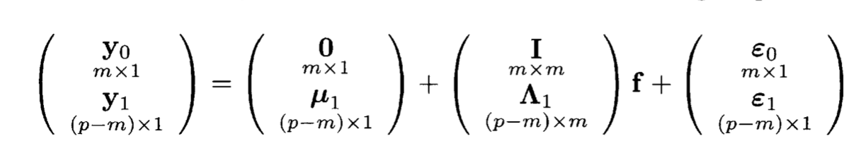
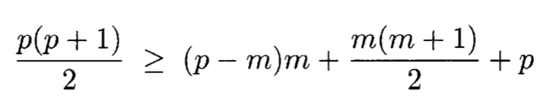
Error in Variables approach

Slide 8
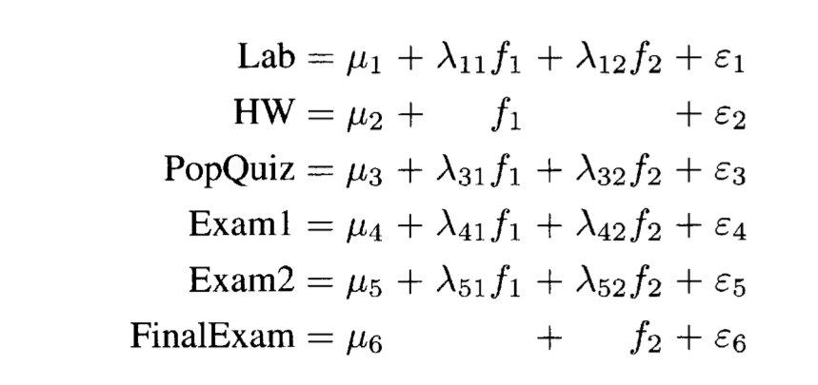
Example 14.2.2
f₁ = daily effort
f₂ = knowledge mastery

Slide 9
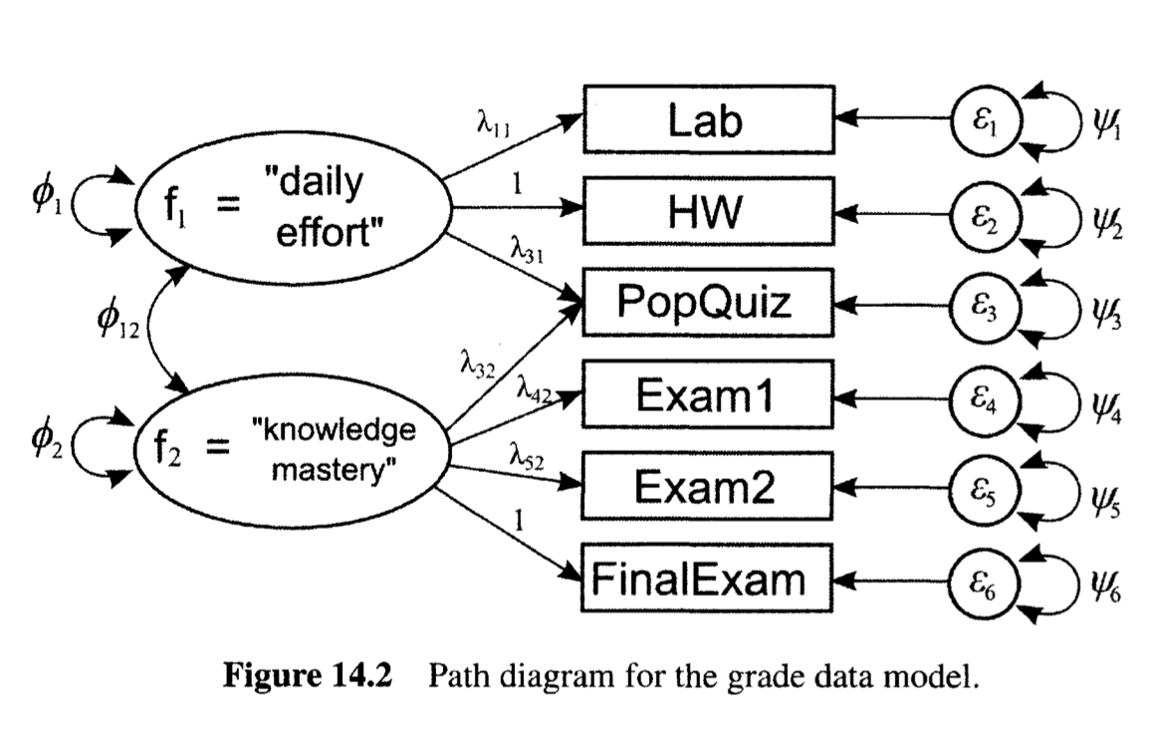
Example path diagram – model to test

Slide 10
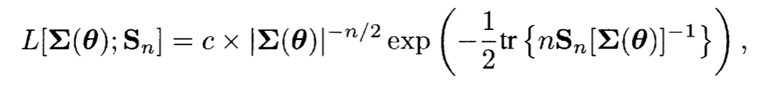
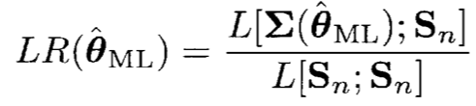
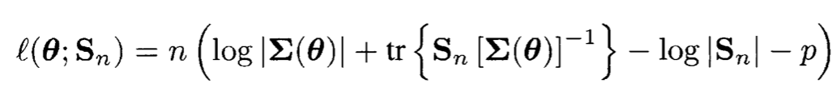
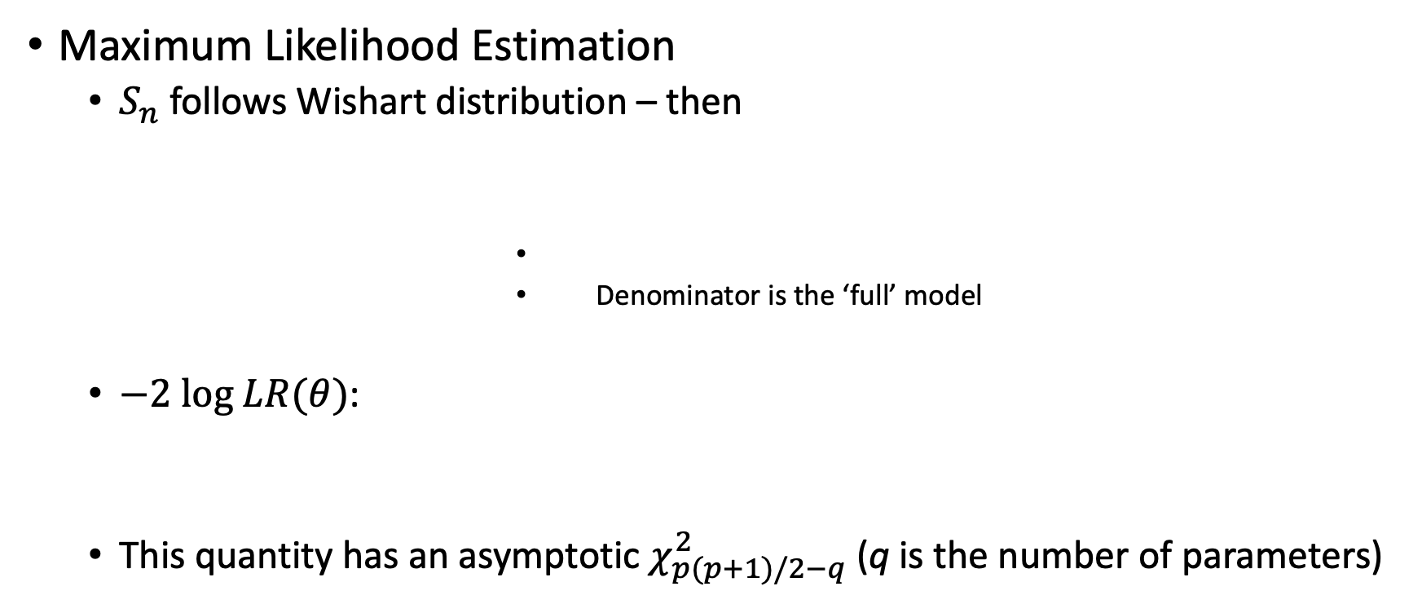
Parameter Estimation and Model Assessment
Maximum Likelihood Estimation
$S_{n}$ follows Wishart distribution – then
Denominator is the ‘full’ model
$−2 \text{log} LR(θ)$:
This quantity has an asymptotic $χ_{p(p+1)/2−q}^{2}$ (q is the number of parameters)

Slide 11
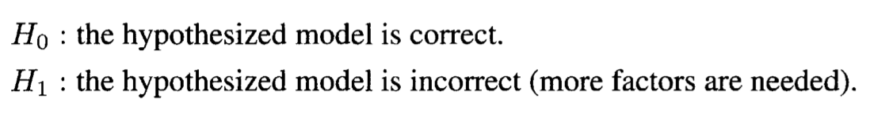

This allows hypothesis test
However, this $χ^{2}$ test can be sensitive to sample size (i.e. small deviations from hypothesis test will cause the model to be incorrect
Remember – null hypothesis are often never true

Slide 12
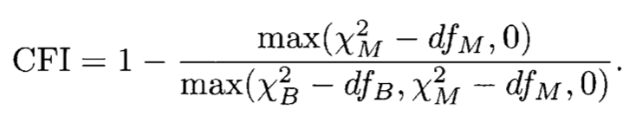
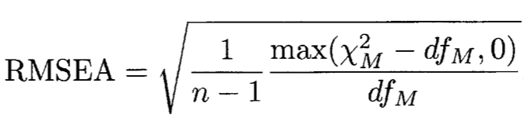
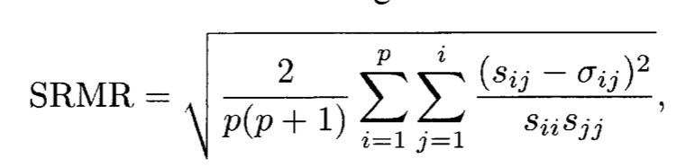

Other measures of fit
Bentler’s CFI – (> .95)
If fit is bad then $χ^{2}≈df$
RMSEA – ( < .06)
SRMR – (< .08)

Slide 13
Final Project Introduction
Find a multivariate data set to explore
Write a mini paper about it (see next slide for details)
Use techniques from class
Present Project (15 minutes)
Use at least two-three different techniques from class as appropriate for your data. Interpret the results appropriately. Recognize and understand limitations in the data.

Slide 14
Final Project Details
Introduction
Description of problem
Background on data set
What’s the goal?
Description of Data
Counts, histograms etc.
What do the columns mean?
What are some of the considerations you will have to make for the analysis
Methods and Results
Keep this section ‘factual’ e.g. don’t draw too many conclusions – just report results
Data Transformation
Modeling Technique
Results
Discussion
What did you learn about the data set? Which variables are important?
How could analysis be improved (e.g. more data?)
How does this translate to real world change?

